Slide 1
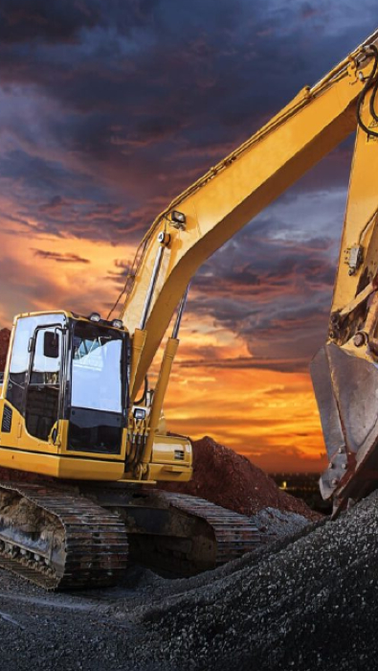

Machine Rental System
Juan Alejandro Sola Castermans,
Herjuno Ridho,
Alpay Demirci,
Rangga aulia,
Jarno Dijkmans

Slide 2
TABLE OF CONTENTS
01
02
03
04
What have we done?
Demo
What’s next?
End

Slide 3
What have we done?
01
UI & UX
Functionalities
Design implementation
Filter by category
Login & Register
Rent steps
Login & Register
Filter by category
Make a rent

Slide 4
Demo
02

Slide 5
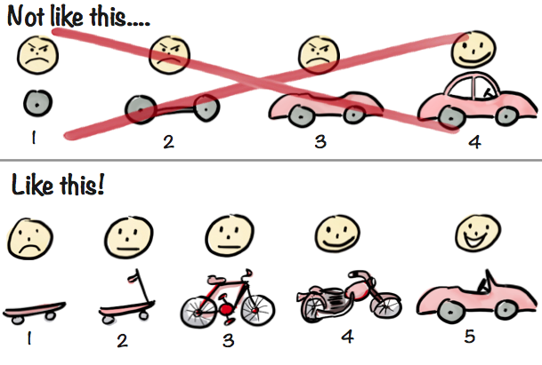
What’s next?
03
- Thoughts about the current design?
- What is the focus now?

Slide 6
THANKS!
Do you have any questions?

